Slide 1
Tt
E-Commerce Price Optimization
A Comprehensive Analysis of Pricing Trends
TrendElite

Slide 2
AGENDA
01
Problem Statement
02
Detailed Analysis and Insights
Dissecting the Problem Statement
Walkthrough of Insights from the Analysis
03
Modelling Results
04
Conclusion and Takeaways
Regression Analysis Results
Summary of Key Takeaways from the analysis
TrendElite

Slide 3
Problem Statement
Introduction
About TrendElite -
TrendElite is clothing store that specializes in a diverse range of apparel and accessories
The company operates both physical stores and an online E-Commerce Platform
It wishes to enhance its revenue and market competitiveness by optimizing its pricing strategy
Project Objectives -
Analyze TrendElite’s Pricing Strategy
Market Understanding & Competitor Study
Suggest Appropriate Pricing Strategy
Challenges Faced By TrendElite -
01
Fierce Competitive Landscape
02
Effective Inventory Management
03
Adjusting to Seasonal and Trend Variations
TrendElite

Slide 4





Problem Statement
Exploring Pricing Strategies
Cost Plus Pricing
Calculate costs and add a mark-up
Competitive Pricing
Price Skimming
Adjust Prices based on Competitor Prices
Set a high price and lower it as the market evolves
Penetration Pricing
Dynamic Pricing
Set a low price to enter a competitive market and raise it later
Dynamically Adjust Prices based on Multiple Factors
TrendElite

Slide 5
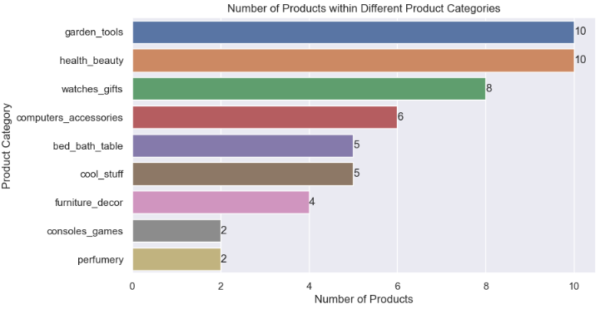
Detailed Analysis & Insights
Pricing Trends
Garden Tools, Health Beauty and Watches & Gifts Product Categories have an abundance of Products within them
Console Games and Perfumery, on the other hand, have only 2 products
TrendElite

Slide 6
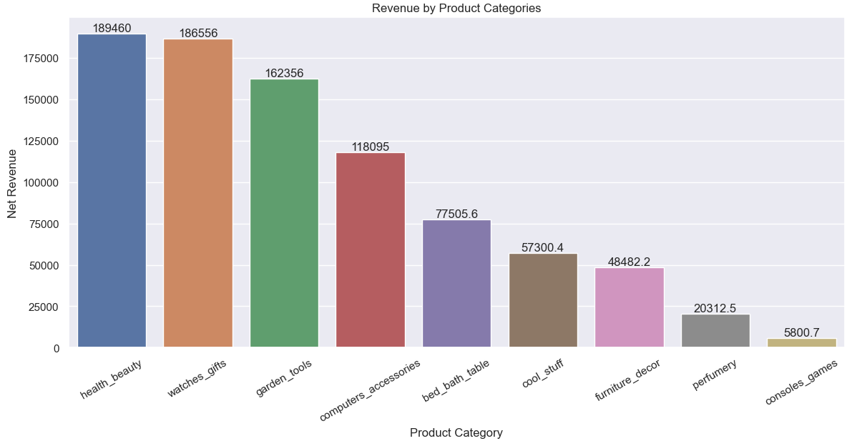
Detailed Analysis & Insights
Revenue & Product Categories
The top 3 revenue contributing Product Categories are Health and Beauty, Watches & Gifts and Garden Tools
Console Games and Perfumery have very little contribution to the net revenue, and need special attention in order to optimize overall revenue
TrendElite should launch more Products within the Perfumery and Console Games Product Categories
TrendElite

Slide 7
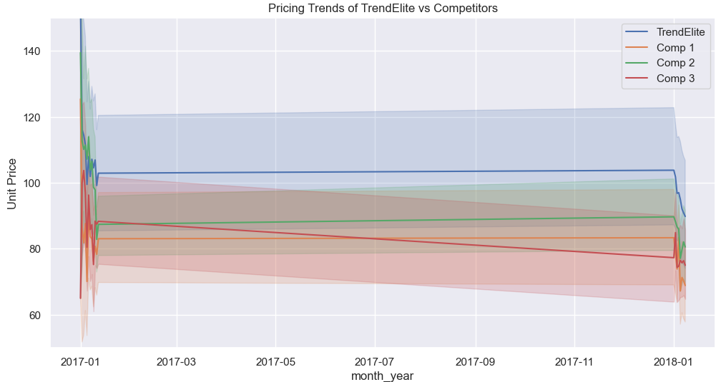
Detailed Analysis & Insights
Pricing Trends
TrendElite follows an aggressive pricing strategy
Average Monthly Product Prices for TrendElite are much higher than all three competitors
Pricing trends for TrendElite as well its competitors remains stable throughout the year, however we’ve observed instability around the holiday season
TrendElite

Slide 8
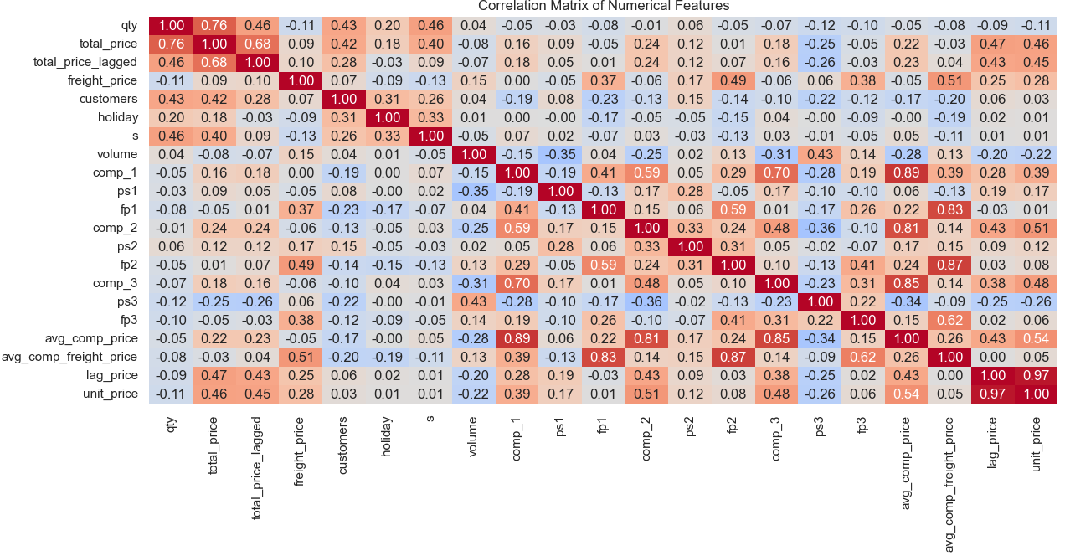
Detailed Analysis & Insights
Pricing Trends
Below features have highest Correlation with Unit Price -
Lag Price (0.97)
Avg Comp Price (0.54)
Comp 2 Price (0.51)
Last Month Revenue (0.45)
Competitor 2 Price (0.48)
Competitor 1 Price (0.39)
It is worth noting how Competitor Prices are highly correlated to Average Comp Price (for obvious reasons)
* Total Price Lagged, Average Competitor Price and Average Competitor Freight Price are all engineered features
TrendElite

Slide 9
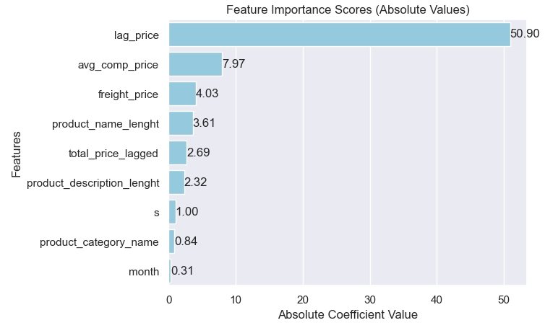
Modelling Results
Regression Analysis
MultiVariate Analysis Summary
Model Used - Linear Regression
Test R-Squared & R Squared Adjusted Value - 0.96 (Both)
Multi-Colinearity completely eliminated using VIF
Removed Features - Last Month Profit, Product ID (Target Encoded feature)
Key Predictors of Unit Price - Last Month Unit Price, Avg Comp Price
Least Useful Predictors - Month, Product Category Name, Seasonality
TrendElite

Slide 10




Conclusion and Takeaways
Summary of Key Takeaways from the analysis
Recommended Pricing Strategy
Competitor Analysis
Based on Market and Competitor Analysis, it would be best for TrendElite to incorporate a Dynamic Pricing Model
TrendElite must keep an eye on the average Competitor Price, and adjust thier product prices accordingly
Low Contributors to Revenue
Key Predictors
Console Games along with the Perfumery product categories have the least contribution to revenue and need special focus to improve net revenue
Previous Month product price and Average Competitor Price are the two most important factors that determine Product Price
TrendElite

Slide 11
THANK YOU
TrendElite

